Slide 1
Disclaimer
These slides are intended as presentation aids for the lecture. They contain information that would otherwise be to difficult or time-consuming to reproduce on the board. But they are incomplete, not self-explanatory, and are not always used in the order they appear in this presentation. As a result, these slides should not be used as a script for this course. I recommend you take notes during class, maybe on the slides themselves. It has been shown that taking notes improves learning success.

Slide 2
Reading for this set of slides
Craig – Intro to Robotics (3rd Edition)
1 Introduction
2 Spatial descriptions and transformations (2.1 – 2.9)
3 Manipulator kinematics (3.1 – 3.6)
7 Trajectory generation
Please note that this set of slides is intended as support for the lecture, not as a
stand-alone script. If you want to study for this course, please use these slides
in conjunction with the indicated chapters in the text books. The textbooks are
available online or in the TUB library (many copies that can be checked out for the entire semester. There are also some aspects of the lectures that will not be
covered in the text books but can still be part of the homework or exam. For those
It is important that you attend class or ask somebody about what was covered in class.

Slide 3
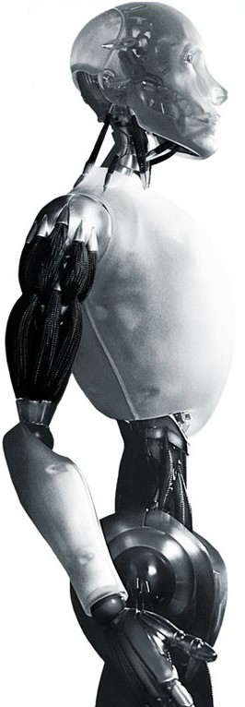
Robotics Basics of Control – A Second Look
TU Berlin
Oliver Brock
TexPoint fonts used in EMF.
Read the TexPoint manual before you delete this box.: AAAAAAAAAAAAA

Slide 4

Control
Control is the process of causing a system variable to conform to some desired value, called a reference value.
Feedback and feed-forward
Disturbance
Reference
Generator
+
Control
Function
Plant
-
Sensor

Slide 5
Controlling a Robot
Goal
Goal
Joint Space
Operational Space

Slide 6






Control with Inverse Kinematics
Inverse Kinematics
+
Control
Robot
-

Slide 7
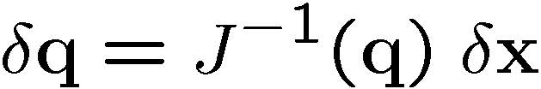



Operational Space Control with J⁻¹
+
Control
Robot
-
Forward Kinematics

Slide 8
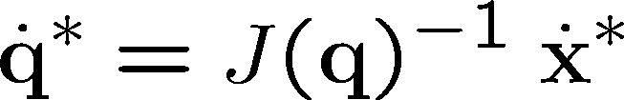
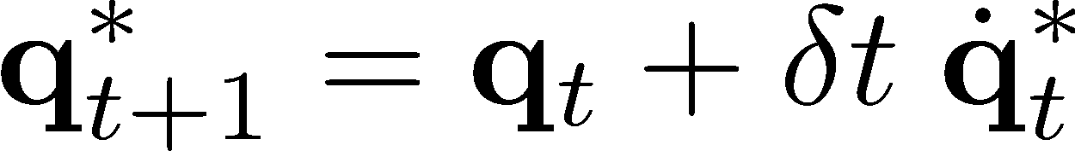

Operational Space Control with J⁻¹ Resolved-Rate Motion Control
+
+
Control
Robot
-
+
Forward Kinematics

Slide 9
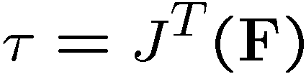



Operational Space Control with J^{T}
+
Control
Control
Robot
-
Forward Kinematics

Slide 10





Spring/Mass/Damper System
viscous friction
Equation of motion
Notes:
http://en.wikipedia.org/wiki/Damping

Slide 11
Possible Behaviors
x
t
Oscillatory-damped Under-damped
x
t
Over-damped
x
Critically damped
t

Slide 12

Notes:
Background image
https://www.pexels.com/photo/background-black-blackboard-board-159770/

